Slide 1

Pathways Towards Success
Notes:
Instructor overview:
Three concepts are woven together in this lesson—deciding vs sliding, pathways and sequence towards success, and through the eyes of a child. Together they offer a way to deepen motivation to decide, to plan, to follow the success sequence and build agency into one’s life.
This lesson starts by introducing an important concept: Decide, Don’t Slide! This concept is an essential piece of following success pathways to build agency in one’s life.
Introduce lesson to students:
❖ Today we’re going to focus on your future. Research has revealed that there are specific pathways to follow towards success that are more likely to get you there.
❖ Before I share with you these “secret ingredients for success,” I first want to introduce you to a concept called Sliding vs. Deciding.
❖ By sliding, I mean just going along in life and kind of just letting things happen.
Deciding is about being intentional, gathering information, making clear decisions, and then taking steps to get to where you want to go. This can be applied to lots of things in life.

Slide 2


Are you Sliding...
or Deciding?
Notes:
❖ When we slide into our choices without stopping to think ahead, we run the risk of winding up in places we never planned to be—sometimes with some serious high-cost consequences.
❖ On the other hand, when we make intentional choices that align with our personal goals rather than just letting things happen to us, it opens up our options for the future. Deciding is a much safer way to go when it comes to important things that can be life-altering, like finishing high school and preparing for a career.
❖ When you slide through important decisions, you often trade short-term ease for long-term challenges. But when you decide—when you plan ahead—you keep more doors open. You give yourself choices. That’s true in relationships, and it’s just as true in money.
❖ Let’s explore some examples of how sliding and deciding may impact your finances and your futures.

Slide 3
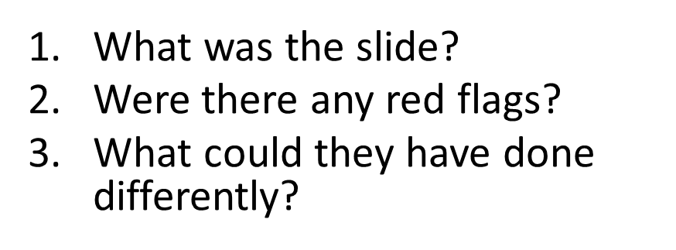

ACTIVITY: Turn back the clock ​on a High-Cost Slide​
Now go back in time. What steps might have been taken, information gathered, and decisions made to have avoided the high-cost slide?
Notes:
Select one or two High-Cost Slides activity cards (attached in lesson) that you feel will engage your students. Work on them together as a whole group. Instructor Note: If you have more time, divide into small groups and use one card per group.
Directions:
❖ I am going to read aloud a sliding scenario and then tell you what happened later.
❖ Your job is to imagine the person in the scenario has a “do-over” opportunity. So, turn back the clock and think about what this person could have done differently to avoid what happened.
❖ What steps might have been taken or information gathered? What decisions could have been made instead of the slide?
❖ Think about these questions:
- What was the “slide”?
- What were the red flags or warning signs?
- What decision(s) could have been made differently?
- How would that have affected the person’s financial stability and options for their future?
Listen to their answers and then what the person could have done differently. (Perhaps they’ll say, “The slide happened when..., A red flag was..., A risky situation was..., They could have talked about... done this or that....”)
Activity Debrief
❖ As we’ve seen through these examples, deciding helps us stay in control of our future—in school, relationships, work, and money.
❖ So, now let’s talk about what research shows us are the key decisions young people can make that help most of them avoid being poor and build a stable, financially successful life. These steps are sometimes called the Success Sequence.

Slide 4
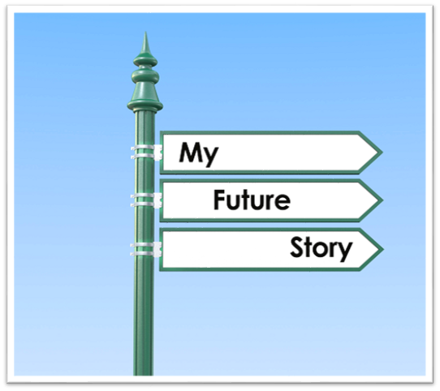
Expectations for Your Future
Notes:
This section will introduce the Success Sequence and will review the research illustrating how it impacts individual and family finances and relationships.
❖ Let’s start by reflecting on some of your expectations for your future—think five-to-ten or more years down the road:
❖ When you think about your future adult life, how many expect or hope to have enough money to live on? To avoid poverty? To live a comfortable middle-class life?(Pause for show of hands.) How many of you hope to have kids someday? For those of you that are raising your hand, how many of you hope to be able to provide your kids with an emotionally and financially stable family life—with parents who are in a loving, committed relationship, and who can provide adequately for their needs? (Pause for show of hands.)
Instructor Note: While you can expect everyone to say they want financial wellbeing for their futures, you will have a greater diversity with the second expectation question. Acknowledge the fact that while everyone wants to avoid poverty in adulthood, not everyone expects/desires to have children.
❖ Thanks for sharing your expectations.
❖ Do you have any ideas of what things a person can do to up their chances of achieving one or both of these expectations? (Pause for brief responses.)
❖ If you desire to have a middle-class income or higher and avoid being poor by the time you're in your 30s, achieving certain combinations of life’s big milestones can increase your odds.
❖ They may also be associated with either increasing or decreasing your chances of family stability by your 30s.
❖ In other words, success doesn’t happen by accident. It happens when people hit a few key milestones—and often, the order or sequence matters too. Let’s take a look at what these steps are, and how they can shape your financial future.

Slide 5
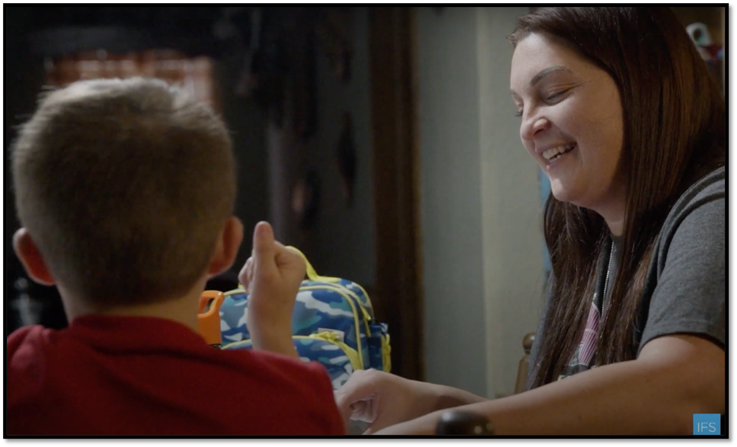
The Success Sequence: Her Story
Notes:
❖ We’re going to watch a short video that will introduce these steps with a real-life example.
Click on the image to play the video. (https://www.youtube.com/watch?v=Hyxul-rv4oA)
Instructor Note: This video is part of a series produced by the Institute for Family Studies featuring the stories of real young adults who are seeking to follow a success pathway and sequence or working on getting back on track. In this video, Stephanie, a young single mom who has struggled with drug addiction and other difficult challenges as a teenager, makes changes to get back on track for herself and her son. The video mentions drugs and childhood trauma. Consider adding a trigger warning for your students.
Video Debrief:
❖ Were your guesses right? What were the steps that were mentioned?
❖ Let’s break these down one by one and talk about why they matter so much—especially when it comes to your future income, savings, and ability to support yourself and a family, if that’s part of your goals.

Slide 6








Milestones
A certain number, combination, and sequence can matter
Notes:
❖ These milestones are:
- Completing high school (or even further education or training)
- Beginning full-time employment
- Getting married before having children
❖ Almost all young people who follow one of the pathways I will describe involving these steps avoid being poor and are more likely to land in the middle to upper-income groups by the time they are in their 30s, whether born rich or poor.

Slide 7

Key Essentials for Increasing Your Odds
of Higher Income
Education/Training
Full-time Employment
Notes:
❖ Finishing high school (or even more education or training) and
❖ Full-time employment by age 25 (or enrolled in further training/education) are key actions for having better financial outcomes by your early 30s.

Slide 8
Adding to Income
Notes:
❖ A healthy marriage can add to income level. Adults who achieve these three (education, employment, marriage) almost always achieve a middle-class lifestyle and avoid being poor by their early 30s.
❖ Does anyone have an idea of why marriage might matter here? (Pause for responses before continuing.)
❖ Marriage can mean the combining of two potential incomes, and those combined earnings can build over the years.
❖ Cohabiting relationships, on average, are much more likely to break up, thus losing the advantage of combined earnings.

Slide 9

If you hope to have kids someday, what kind of life would you want to be able to offer them? What would you need in place—emotionally, financially, relationally—to give them the life you dream about?
Notes:
Introduce activity:
❖ Now, let’s examine when the best time is to add children to the mix. Take a minute to think about and write down your answers to these questions:
❖ 1. If you hope to have kids someday, what kind of life would you want to be able to offer them?
❖ 2. What would you need in place—financially, yes, but also emotionally and relationally—to give them the life you dream about? Think of all the things that would help a child grow up healthy and happy.
❖ If children aren’t part of your vision for your future, that’s okay. You can still participate. Everyone can focus on what they think a child would need and want for their healthy development.
Give students 1-2 minutes to write down their thoughts.
❖ Go ahead and turn to the person next to you and share some of the things you wrote down.
Give students 1-2 minutes to share with their neighbors.
❖ Would a few of you mind sharing with the class? You can share your own ideas, or if your neighbor had a really good thought, you can share that. (Pause for responses.)

Slide 10

When Children are Part of Your Vision
Marriage before baby
Advantage of Combination and Sequence
Notes:
❖ Thanks so much for sharing your thoughts. For those who envision children in their future—and desire to do so with a partner in the context of a stable and satisfying relationship—the marriage factor matters, and the sequence of doing that before having a child can make a big difference.
❖ Hopefully, you’ve had the opportunity in your health classes to discuss in more detail the importance of building a strong marriage relationship for creating a stable family life and a healthy environment for your children to grow and thrive. So, we won’t explore this issue in much depth. Maybe just a quick reminder:
❖ In research, the marriage milestone has been consistently linked with family stability. This means:
1. The presence of 2 adults in the home;
2. No or few changes in live-in partners (break-ups and divorces);
3. Partners who are happy and satisfied with their relationship.
❖ These are some powerful benefits to getting married before having kids and would likely improve your chances of providing your children with the life you envision for them.
❖ For the purpose of this class, however, let’s bring the focus back to finances. How does the timing of marriage and children influence your economic picture? (Pause for responses.)
Instructor note: If the students don’t bring them up, be sure to discuss these issues:
❖ Having a child as a teen may make it difficult to finish high school. Caring for a child while finishing school is doable but more challenging. And without an education, a person may be at a disadvantage in finding good-paying employment.
❖ Without a committed partner, a parent may be on their own financially. Neither parent may have the earnings to cover the expenses of a child, housing, etc.
❖ Even if one parent has achieved high school completion and is working, if they don’t have a partner to share in childrearing, it is challenging on many fronts. Children take a lot of time, care, and money.
❖ It really does make a difference to have finished high school, and even acquired additional education or training, to be employed, and to have a committed partner before having a child.

Slide 11

Does when you marry matter?
Notes:
Instructor Note: Be sure to present this information in a respectful way that simply relates the research and avoids moralizing students’ choices for when to marry and start a family.
❖ It’s important to note that in some communities—including here in Utah—young adults often marry and start families earlier than national averages. That isn’t a bad thing. In fact, marriage can offer emotional support and stability that help people through challenges.
❖ And although a lot of people these days think that it’s best to wait until your late 20s or 30s to marry and settle down, recent research finds that couples who marry in their early-to-mid 20s have just as healthy and satisfying relationships, on average, as those who marry later. (Marrying in your teens, however, still comes with a higher risk of a divorce.)
❖ At the same time, research shows that finishing education and getting established in the workforce first can give you a stronger financial foundation. It doesn’t mean you have to delay family life forever—just that planning and preparation help ensure your family goals and financial goals can work together, not compete.
❖ So, if you do want to marry and have children early, it’s even more important to think about how you’ll complete your education, build career momentum, and plan for childcare and expenses. Deciding—rather than sliding—into these milestones gives you more flexibility, more financial security, and more peace of mind.
❖ If someone wants to get married and start a family in their early 20s, what are some things they could do to financially plan and prepare now to make that path work well? (Pause for responses.)

Slide 12
When Children are Part of Your Vision
Marriage before baby
Advantage of Combination and Sequence
Notes:
❖ Now, why do we include marriage as a milestone for those who desire children and financial stability, and not, let’s say, just living together? A few points:
❖ First, research finds the majority of couples who cohabit pretty much “slide” into it rather than making a well-thought-out, intentional decision about it and what it means for the future.
❖ Also, the research shows these good financial outcomes for marriage but not for cohabitation.
❖ Third, we know from research that cohabiting relationships are much more unstable—there are more break-ups and re-partnering. As more young adults enter into and end cohabiting relationships, a pattern of multiple or serial cohabitations has increased.
❖ Perhaps an upside to this is that young people may be learning to end cohabiting relationships that aren’t working.
❖ But the downside is that if the cohabiting relationship includes children (as 54% do), and the relationship ends and is followed by another relationship (and possibly another), all those changes in people and homes—all that instability—can be rough on a child.
❖ When you are trying to provide your family with both financial and emotional stability, a healthy marriage is going to be the best option in most cases.

Slide 13
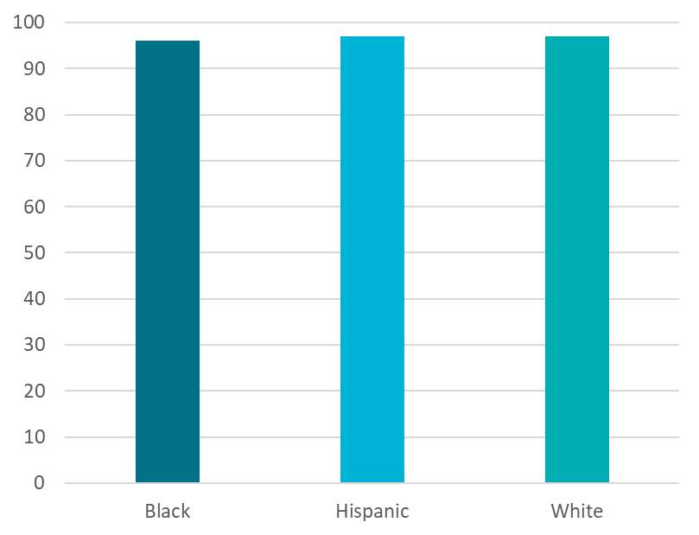
97% of Black, Hispanic and White young adults . . .
Who achieved milestones of high school education, employment, and marriage before baby...
Avoid Poverty by mid-30’s young adulthood.
Notes:
❖ Let’s wrap up this section of our lesson by examining some more research that looked at thousands of 32-38 year-olds who followed one of these pathways to success.
❖ 97% of young adults who achieved the education and employment milestones and followed the sequence of marriage before baby avoided being poor by their mid-30s. And this was true for Hispanics, Blacks, and Whites. That's impressive!
Instructor Note: Asian millennials were included in the data for this study, but their results are not reported because of a small sample size (<100).

Slide 14
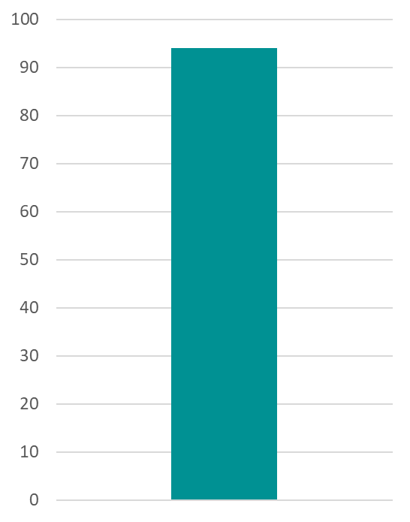
94% of young adults from low-income families …
Who achieved milestones of high school education, employment, and marriage before baby...
Avoid Poverty by mid-30’s young adulthood.
Notes:
❖ Also, 94% of young people who grew up in low-income families but followed the Success Sequence avoided being poor by their mid-30s.

Slide 15

96% of all young adults are “on track”…
Who achieve high school education and employment milestones and are not married/no children...
Avoid Poverty by mid-30’s young adulthood.
Notes:
❖ Of course, not everyone wants to marry and have children.
❖ 96% of those who have achieved milestones of high school education and employment and no marriage/no children also avoided being poor by their 30s.

Slide 16

Achieving Middle or Upper Income
The vast majority of young people who follow one of the pathways and sequences for success land in the middle- or upper-income levels by their mid-30’s.
Notes:
❖ Now, avoiding being poor is wonderful, but most people hope for more—most want to achieve a middle to upper-income level, not just avoid poverty. The good news is that the vast majority of young people who follow one of the pathways and sequences land in the middle- or upper-income levels by their mid-30s.
Instructor Note: There is living below the federal poverty line and living just above that line. The analysis done by Wang and Wilcox divided the U.S. income percentiles into three groups. 1/3 includes those under the poverty line plus others who are low-income but over the poverty line. 1/3 middle income and 1/3 upper income. Using these three income brackets, 86% of Hispanics, 80% of blacks, and 82% who grew up in low-income homes who followed the Success Sequence not only avoided landing in the bottom 1/3 but achieved the middle or upper-income level by their mid-30s.
❖ So, what happens if we stumble on our pathway to success? We are bound to make mistakes and slide into some decisions that have unwanted consequences. Maybe we aren’t on track to graduate. Maybe we become a parent much sooner than we’d planned.
❖ Unfortunately, we can’t turn back the clock like we imagined in our "High Cost Slides” activity. Does the research show there is hope for when we slip up?

Slide 17
Success for Young Parents Combinations and Sequences
1. Focus on being the best parent you can be.
2. Finish high school and get as much college or training as you can.
3. Obtain employment.
4. Decide, don’t slide with your love life. Have a committed partner—a spouse—BEFORE having a second child.
Notes:
❖ For young parents, there are milestones and a sequence that can increase the odds of having the life you want:
❖ 1. Focus on being the best parent you can be. There are resources here in Utah to help you build up your parenting knowledge and skills. Healthy Relationships Utah (https://extension.usu.edu/hru/) offers free parenting and relationship classes all over the state, and the Utah Marriage Commission (https://extension.usu.edu/strongermarriage/) has lots of free online classes and resources for parents. You can also reach out to a family resource center or the public health department in your area for programs for health, nutrition, and financial assistance for young parents.
❖ 2-3. Finish high school and get as much college or training as you can to help you obtain better employment. Seek support from a caring teacher or school counselor who may be able to help you stay on track or get back on track for graduation or obtain a high school equivalency. See a career counselor at your local community college to learn more about vocational, technical, apprenticeship.
❖ 4. And most importantly: Decide, don’t slide with your love life. Use the relationship skills you’ve learned in health class to help you make wise relationship choices. Avoid sliding into an unstable or unhealthy relationship or a second pregnancy.
Instructor Note: Be familiar with the resources and supports in your community for young parents.

Slide 18
Key Takeaways
What were your key takeaways?
Notes:
❖ So, what are our key takeaways from this research? What stood out to you? (Pause for responses.)

Slide 19
Key Takeaways
1. Following the Success Sequence significantly increases your chances of not being poor and of having a more stable and happy family life by your mid-30s.
2. If you want to have kids, marriage matters.
3. It’s never too late to get back on track.
Notes:
❖ 1. Research shows that making three major life decisions significantly increases your chances of not being poor and of having a more stable and happy family life by your mid-30s. These results are true regardless of your race and financial or family background. This is referred to as the “Success Sequence,” and it includes:
- Completing high school (and even further education or training);
- Gaining full-time employment; and
- Getting married before having children, if children are part of your future vision.
❖ 2. If you want to have kids, marriage matters. Not just for your relationships, but for the financial wellbeing of your future family, as well.
❖ 3. If you stumble on your path to success, don’t give up on yourself. It’s never too late to make changes and get back on track.
❖ Planning now—deciding instead of sliding—can help you build the foundation for your future, step by step.

Slide 20

My Success Plans
Notes:
This final part of the lesson reinforces the importance of planning and intentional decision-making which is crucial to developing agency—and ultimately to following a pathway towards success.
❖ Now that we’ve seen what the research says and discussed some of the key life decisions that can affect your future, it’s time to turn the spotlight back on you.
Pass out attached worksheet, My Success Plans. Give students 10-15 minutes to complete the worksheet.
Directions:
❖ This worksheet is made up of questions to help you think through and apply the principles you’ve learned in class today to your own goals for the future. Think carefully about your answers and fill out as much as you can for the remainder of the class period.
❖ It’s okay if you’re not sure about some of these answers yet. Just do your best to be honest and thoughtful. If you have any questions, I’m happy to help.
Activity Debrief
After they are done, ask:
❖ How do you think having a plan—about school, money, or family—could help you avoid sliding?
❖ What’s one thing you want to decide—not slide—about in your life this year?

Slide 21
Homework
Share your success plans with a parent or trusted adult. Talk with them about what you learned today, and discuss this question:
“What advice would you give your 16-year-old self about money and life choices?”
Notes:
Instructor Note: Discussing goals and plans with a trusted adult can help students feel more accountable and can also provide opportunities for important connection and relationship-building at home. You can assign this task for points or simply invite the students to share what they learned in class.
❖ Your homework for today is to go and share your success plan with a trusted adult. Talk with them about what you learned today, and discuss this question:
❖ “What advice would you give your 16-year-old self about money and life choices?”

Slide 22
Love Notes
Use of the free PowerPoint Presentation is limited to the accompanying purchased curriculum. Slides may be deleted or additional slides can be added to our base presentation for the sole purpose of teaching the Love Notes curriculum. However, reproduction of art and photos in the presentation is unauthorized.
Presentation created in Canva.
Photos used with permission from Canva, IStockPhoto®, BigStockPhoto, and AdobeStock. All Rights Reserved.
Some clipart created and used with permission from Randy Clark.
Additional art and photos used with permission from PREP® and Canva. All Rights Reserved.
Copyright © 2025. The Dibble Institute. All Rights Reserved.

