Slide 1
Basic Economic Concepts
Producers, Consumers, Goods & Services

Slide 2
Producers:
People who make goods or provide services.
Producers usually receive income for their work.
Notes:
Producers are people who make goods or provide services. Producers receive income for their work.
Ask students what these people might be producing.

Slide 3
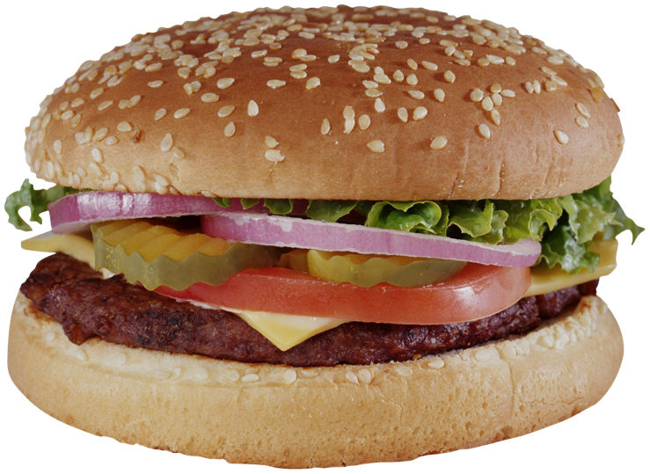
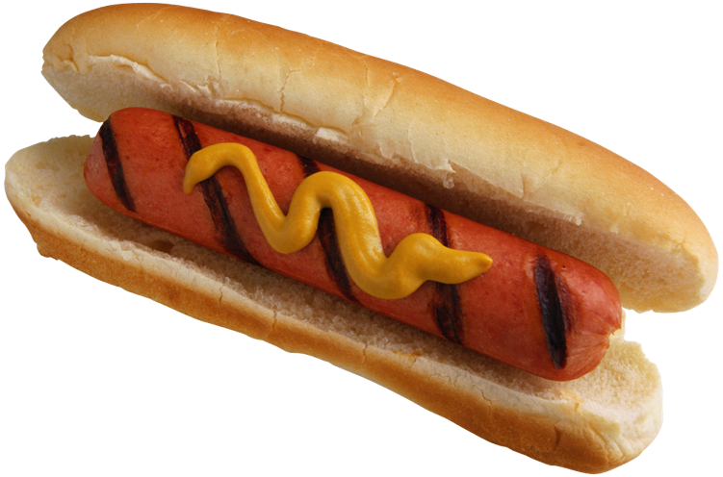
Consumers:
People who buy services and goods.
Consumers have many choices to make about what to buy.
Notes:
Consumers are people who buy services and goods. Consumers have many choices to make about what to buy.
This softball team is made of consumers. They make choices every day about what products they buy and use. An example of a choice they might make is where to have dinner after the game and where to buy their dinner.

Slide 4
Consumers cannot buy everything they would like because money is limited.
People make choices about which good and services they want and need.
Their decisions determine what producers make.
Notes:
Consumers cannot buy everything they would like to because money is limited. People’s choices about which goods and services they want and need determine what producers make.

Slide 5
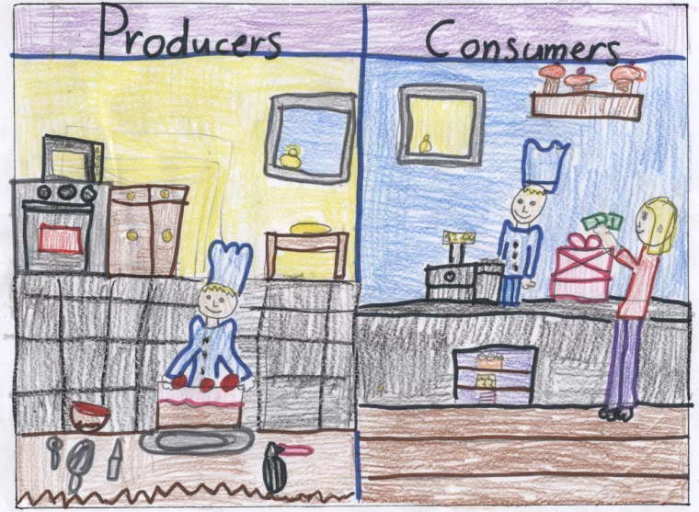
Notes:
This is a student drawn example of producers and consumers. The baker produces a cake and a consumer purchases it.
Website for image Thinkfinity.com

Slide 6
Goods and Services
Goods
Services
Physical objects that are made that can be weighed or measured.
Tasks performed by people or machines.
Notes:
Goods are physical objects that are made that can be weighed or measured.
Services are tasks performed by people or machines.

Slide 7
Notes:
Picture source: http://icubed.edublogs.org/student-showcase/economic-posters/

Slide 8
You Try It…
Fold a piece of paper in half.
Choose either
Goods and Services or
Producers and Consumers
Draw a picture similar to the ones shown that describe your choice.

