Slide 1
Penny Puzzler

Slide 2
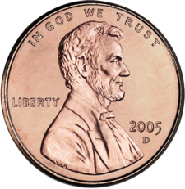
Challenge: USING 12 PENNIES, MAKE A SQUARE using THE SAME NUMBER OF PENNIES ON EACH SIDE

