Slide 1


Payday LOANS
Short on Credit, Long on Debt
Preston Cochrane, President & CEO
FairCredit.org

Slide 2

DISCLAIMER
This presentation is designed for informational and educational purposes only; it is not intended to provide legal, tax, or investment advice. No part of this presentation may be reproduced without prior written consent from the presenter.

Slide 3
Our Mission
Help individuals and families achieve lasting financial stability through programs and services that incorporate five key principles: Learn, Earn, Save, Invest and Protect.

Slide 4




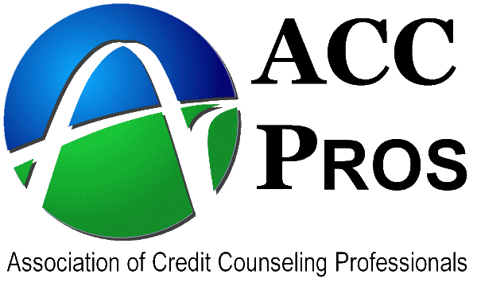





About Us
ISO 9001:2008
FS 59910
Notes:
Nonprofit, Founded in 1997, Located in SLC

Slide 5





Strategic Initiatives
utahsaves.org
believeinyourfuture.org
utahtaxhelp.org
faircredit.org
Notes:
Founded in 1997 / Located in SLC, UT

Slide 6
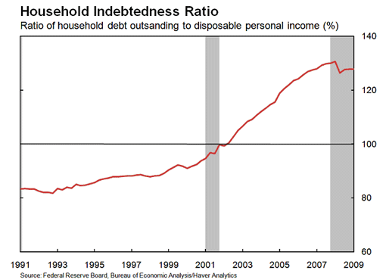
Notes:
During the financial crisis, which began in August 2007, and the resulting recession, which began in December 2007, the trend towards increased household leverage reversed itself. There are three likely scenarios: either households are borrowing less or paying down their existing debt—or both.

Slide 7
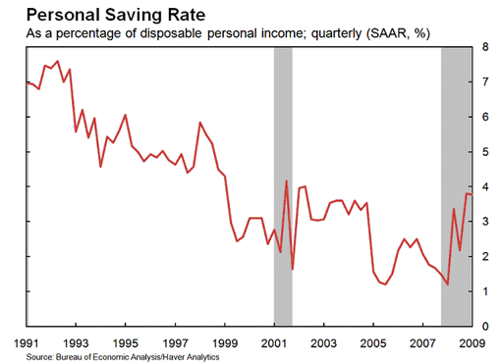
Notes:
This chart indicates that households are saving a much larger share of their disposable personal income. In the first quarter of 2008, the personal saving rate matched an all-time low of 1.2 percent of disposable personal income (on a quarterly basis); by the fourth quarter of that same year, the saving rate had climbed to 3.8 percent (on a quarterly basis), the highest it had been since 2002. These changes in household behavior have important implications for consumer spending and overall economic performance. The increased saving rate—a result of consumers’ attempt to protect themselves against increased economic and financial uncertainty following the onset of the financial crisis and recession—also means a smaller share of each dollar of income will be spent on goods and services.

Slide 8
What is a Payday Loan?
Small consumer loan
Secured by borrower’s post-dated check
Due back in single balloon payment
Short-term loan (2 weeks)
Triple digit APR (400%)

Slide 9
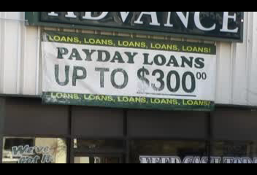
Notes:
Strategically located in low-income neighborhoods, payday loan stores reap significant profits from a product designed to force borrowers into repeat loans. With each loan renewal or flip, borrowers become unable to both repay the lender and have enough money left until the next payday arrives. The trap of recycled debt is also how billions are taken each year from poor people.

Slide 10
Rinse, Wash, & Repeat
“You’ve got to get that customer in, work to turn him into a repetitive customer, long-term customer, because that’s really where the profitability is.”
-- Dan Feehan, CEO of Cash America, June 20, 2007
“A note about rollovers. We are convinced the business just doesn’t work without them.”
Roth Capital Partners, First Cash Financial Services, Inc.
Company Update, July 16, 2007

Slide 11
The Facts
Nationally, there are more than two payday lending storefronts for every Starbucks location.
The typical two-week payday loan has an annual interest rate ranging from 390 to 521 percent.
The “churning” of existing borrowers’ loans every two weeks accounts for three-fourths of all payday loan volume.
The typical borrower remains in payday loan debt for 212 days of the year.
Seventeen states and the District of Columbia have enacted double-digit rate caps on payday loans.
Notes:
Payday loans are small loans marketed as a quick, easy way to tide borrowers over until the next payday. First-time payday borrowers take out a loan expecting a quick fix to a financial shortfall. Loans must be repaid in full from a single paycheck which is a tall order for a household already living close to the edge. Dependence on payday loans often leads to long-term indebtedness.

Slide 12
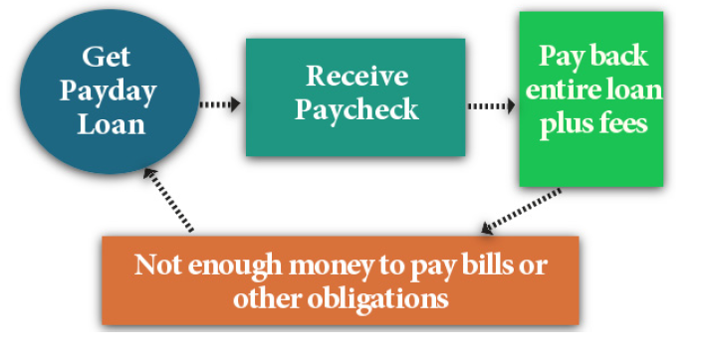
How Payday Lending Works
Notes:
The payment schedules are set up so that many low-income borrowers can't handle the principal repayment in such a short, two-week borrowing window after shelling out for the high fees and normal living expenses, too. They are trapped in a cycle of debt as long as they are drawing paychecks. If they lose their job, many are plunged into bankruptcy. The only way out of the trap is if you get a better-paying job or the housing market continues to soar and you can refinance. Recent years have shown that both of those outcomes for many have been false hopes.

Slide 13
The Cycle
Designed as a 2 week loan
  Pay only the interest, Roll over 5 times
If you don’t have the $ today, how would you have it in 2 weeks?
  In two weeks, there are other expenses the paycheck is used for
  The interest payment is made, the balance remains the same
Amplified stress and arguments about $

Slide 14

At the End of 12 Weeks
You must pay the debt in full
Cannot receive another payday loan on that same day (from that store)
  Title 7 Chapter 23 Section 401 - 4
How to get past this?
  Get a loan from another payday store
  Pay the loan today, new loan the following day

Slide 15
How Much Interest to Borrow $500?
Loan APR 7 Months 12 Months
Payday loan 400% $1,200 $2,000
Credit card advance 28% $76 $140
Finance company loan 36% $54 $99
Credit union or bank loan 18% $26 $48
Salary Advance 12% $35 $65
(plus would build up to $300 in savings)
Notes:
400% APR, so if you borrow $500 and have the loan outstanding for a full year (not unusual since folks flip the loans repeatedly), you will pay $2000 in interest over that 12 months and still owe the original $500.

Slide 16
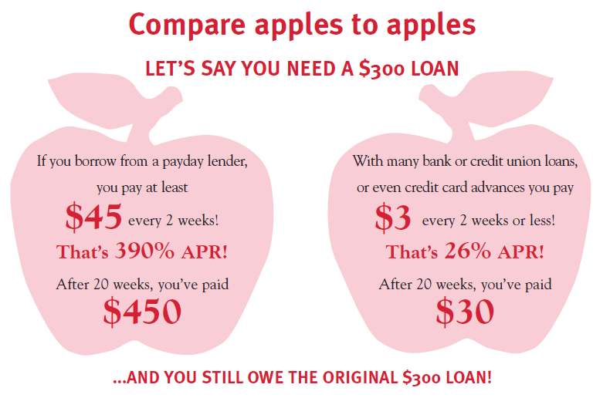

Slide 17

Common Complaints
They threatened to:
  Garnish my paycheck
  Sue me, get a judgment
  Repo goods listed in the contract
  Jail time, check fraud
  Contact my neighbors/family

Slide 18



Credit Effects
Does not build credit. Payments are not reported to the credit bureaus
Only reported if unpaid as a collection or judgment account

Slide 19
Industry Research
Harvard Business School report on unbanking found payday lending appears to contribute to people overdrafting and losing their bank accounts. (Campbell et al, 2008)
Texas study found payday borrowers more likely to end up in bankruptcy than their peers who had applied for a payday loan and been denied. (Tobacman & Skiba, 2008)
Taking out a payday loan makes a borrower 92 percent more likely to become seriously delinquent on their credit card (i.e. 90 days or more late) during the year. (Agarwal, Tobacman & Skiba, 2009)
Access to payday loans increases the chances a family will face a hardship, have difficulty paying bills, or have to delay medical care, dental care, and prescription drug purchases. (Melzer, University of Chicago, 2007)

Slide 20
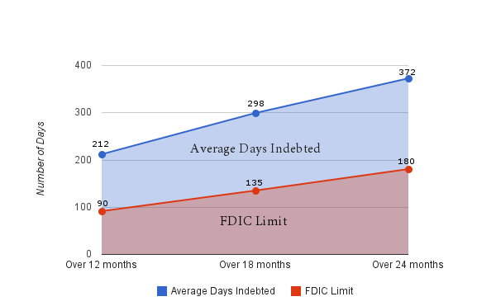
Typical payday borrower is indebted more than 200 days
Source: “Payday Loans, Inc.,” Center for Responsible Lending (2011)
Notes:
In its 2011 report, Payday Loans, Inc., CRL analyzes new data regarding the use of payday loans by borrowers over two years after their first payday loan. In short, it shows that borrowers are typically indebted to payday lenders for much of the year, with those who remain active borrowers taking on more debt over time. This study tracks the transactions of the 11,000 borrowers in Oklahoma who took out their first loans in either March, June, or September of 2006 for the following 24 months.
This graph shows one of the report’s findings – that a typical payday borrower is indebted for more than 200 days, far more than is recommended by the FDIC.
In 2005, the Federal Deposit Insurance Corporation (FDIC) ruled that it is inappropriate for payday borrowers to remain indebted for more than 90 days in any 12 month period, both because “an extension of a payday loan is not appropriate under such circumstances” and because of safety and soundness risks to banks. In 2010, National Credit Union Association adopted similar standards on limits of indebtedness for largely the same reasons.
Even in a state where industry “best practices” are codified, data reveal that borrowers are indebted for more than double the limit recommended by the FDIC and NCUA. For example, in their first year of payday loan use, borrowers are indebted an average of 212 days. Over the full two-year period, borrowers are indebted a total of 372 days on average.
Source: “Payday Loans, Inc.,” Center for Responsible Lending (2011),
http://www.responsiblelending.org/payday-lending/research-analysis/payday-loan-inc.pdf

Slide 21
Nearly half of payday borrowers default within 2 years
…by which time they’ve paid fees and interest
equivalent to over 90% of the loan amount..
Source: “Payday Loans, Inc.” Center for Responsible Lending (2011), and “Payday Loans, Uncertainty, and Discounting: Explaining Patterns of Borrowing, Repayment, and Default,” Paige Skiva and Jeremy Tobacman, (2008)
Notes:
Payday lenders say that over 90 percent of the time, borrowers successfully repay their loan. However, data show that a significant share of borrowers become late or default on their payday loan, triggering more fees and placing their bank account at risk. The 2011 CRL report, “Payday Loans, Inc.,” shows that over the first two years of payday loan use, 44 percent of borrowers will experience a “return event” or default in which they cannot service their payday loan debt in a timely manner. These defaults place additional financial stress on borrowers by triggering bounced check fees from the lender and the borrower’s bank.
This finding is consistent with the Skiba and Tobacman study, “Do Payday Loans Cause Bankruptcy?” in which they looked at over 145,000 payday files from a large Texas-based payday lender and finds an even higher default risk for borrowers. Tracking payday borrowers’ activity from 2000-2004, the authors find that over half (54 percent) of payday borrowers who took out loans on a bi-weekly basis defaulted. The authors analysis’ of this data set also show that by the time a borrower defaults, they have paid nearly 90% of the loan amount in fees, but none of which is attributed to the loan principal.
Sources:
“Payday Loans, Inc.,” Center for Responsible Lending (2011),
http://www.responsiblelending.org/payday-lending/research-analysis/payday-loan-inc.pdf
“Payday Loans, Uncertainty, and Discounting: Explaining Patterns of Borrowing, Repayment, and Default” (2008), Paige M. Skiba & Jeremy Tobacman.
http://papers.ssrn.com/sol3/papers.cfm?abstract_id=1319751

Slide 22

What Others Are Saying…
“
“This legalized form of loan-sharking exploits hard-working families who find themselves in a temporary cash shortage with few convenient or accessible options.“
--Julian Bond, Civil Rights Leader, former Georgia State Senator

Slide 23
Rate cap approved by voters at ballot
Notes:
Today, 17 states and the District of Columbia protect their borders from predatory payday lending by enforcing two-digit interest rate caps. Not a single state has authorized 400% interest rates since 2005, and in fact 5 states have rolled back the authority. Collectively, these states save their citizens $2 billion annually.
In 2006, President George Bush signed into law an act which prohibited 400% interest rate payday loans for members of the military and their families and established a maximum rate of 36% because the high cost loans threatened military readiness and national security.
There have been three recent ballot initiatives in three very different states which show voters prefer rates of 36% rather than 400%. In 2008, voters in Arizona and Ohio defeated payday-sponsored ballot initiatives by 2-to-1 margins in both states, mandating an end to 400% interest rates. In November 2010, 72% of Montana voters approved an initiative to cap the rates of payday loans at 36%. These verdicts occurred despite the payday industry spending millions of dollars to convince voters that 400% interest rates were acceptable. For example, payday lenders spent $30 million in Ohio and Arizona, while statewide coalitions opposing them spent just a small fraction of that.

Slide 24
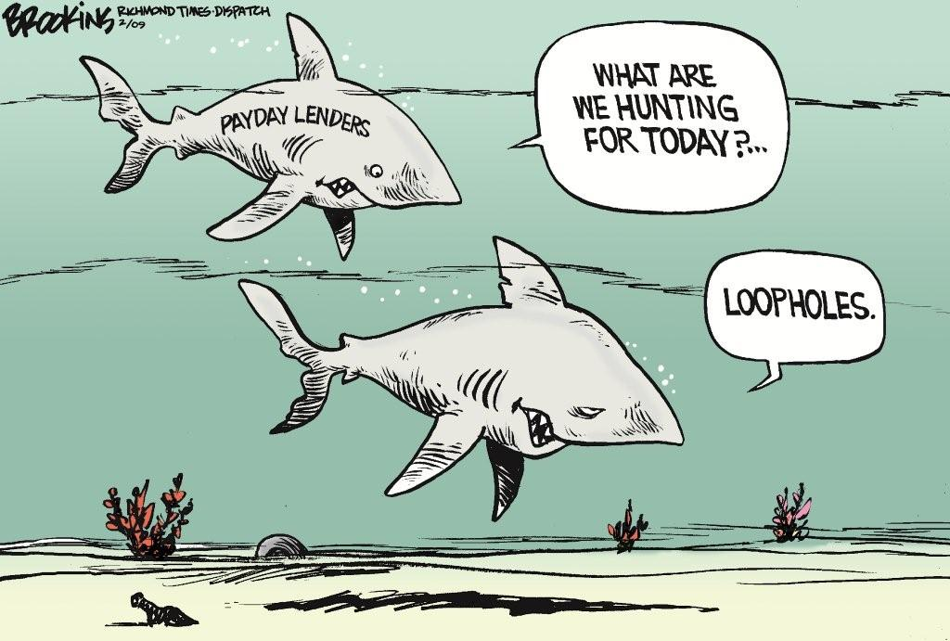

Slide 25
Car Title Loans
Approved by voters at ballot
Notes:
Currently, 19 states have title lenders operating within their borders. Of these, 14 states have explicitly authorized car title lending at triple-digit rates through specific laws or regulations. Over half of these 14 states allow these loans without any limit to the interest and fees charged. In five other states (California, Kansas, Louisiana, South Carolina, and Texas), title lenders exploit loopholes or definitional weaknesses in state laws to make these loans at triple-digit rates to borrowers.
A combination of predatory features present in title loans results in the product being risky for borrowers, such as their high-cost, large balloon payment due in short order, and basing the amount that can be lent largely on the value of an asset rather than their ability to repay the loan. Like payday, car title loans are advertised a quick financial fix, but actually result in long term indebtedness. For example, the President of TitleMax, one of the largest title lending chains with locations in many states, notes that "customer loans are typically renewed at the end of each month and thereby generate significant additional interest payments.“ In fact, the average TitleMax customer must renew their loan 8 times before retiring the debt, stretching their one month title loan to 9 months. (Source: Affidavit of John Robinson, President of Titlemax Holdings LLC, U.S. Bankruptcy Court for the Southern District of Georgia, Savannah Division (April 20, 2009).)
In 2006, President Georgia W. Bush and Congress capped car title loans at 36 percent annual interest for members of military nationwide, citing concerns that these types of loans undermine troop morale and military readiness. The Military Lending Act also prohibited securing loans with the title to the borrower’s vehicle, placing car title loans off-limits to active-duty service members and their families.
Several states, such as Iowa, Oregon, New Hampshire, Florida, and Wisconsin have all capped car-title loan rates at around 36 percent annually or less. In November 2010, Montana voters overwhelmingly voted to cap car-title and other types of small loan products at 36 percent.

Slide 26

Payday Lender Disclaimer
Customer Notice
Payday advances should be used for short-term financial needs only, not as a long-term financial solution. Customers with credit difficulties should seek credit counseling.
Notes:
This disclaimer is listed on the website of a large local payday lending company

Slide 27
Alternatives
Contact an accredited credit counseling agency
Shop around
Ask your bank about overdraft protection
Make arrangements with creditors
Borrow from friends or relatives or seek assistance from religious institutions or social service agencies
If worse comes to worst, compare the cost of late fees (A onetime late fee is much cheaper than repeat fees to a payday lender)

Slide 28


800.351.4195
FairCredit.org
facebook.com/faircredit
aaafaircredit

