Slide 1
UTAH ECONOMY AND
SALT LAKE CITY’S CBD
Presentation by James Wood
Bureau of Economic and Business Research
University of Utah
July 2012

Slide 2
Economic Profile of Salt Lake City’s CBD
Category | Estimate
Employment | 65,450
Wages | $2.7 billion
Office Space | 13.3 million sq. ft.
Retail Sales | $456 million
Retail Space | 1.8 million sq. ft.
Hotel Rooms | 3,200
Hotel Occupancy | 65 percent
Hotel Revenues | $85 million
Housing Units | 4,200
Population | 10,400
Parking Spaces | 37,000

Slide 3
Share of Employment by Sector in CBD
Sector | Percent Share
Office | 82.1%
Restaurants | 11.2%
Retail | 2.6%
Hotels | 2.4%
Manufacturing | 0.1%
Miscellaneous | 1.6%
Total | 100.0%

Slide 4
CBD Retail Sales as Percent of County Retail Sales (Includes clothing , furniture, fast food, restaurants and specialty retail)
 | Sales ( 2011 Dollars) Millions | CBD as Share of County
1996 | $526.4 | 13.9%
2000 | $451.7 | 10.9%
2005 | $508.1 | 11.2%
2006 | $618.1 | 12.2%
2007 | $608.3 | 11.6%
2008 | $523.8 | 11.0%
2009 | $492.6 | 10.6%
2010 | $479.4 | 10.5%
2011 | $455.9 | 11.6%

Slide 5
Selected Retail Sales in SL City’s Central Business District - 2011
Category | Sales (Millions) | Percent Share
Apparel and Accessories | $80.2 | 17.6%
Furniture | $22.5 | 4.9%
Eating & Drinking | $268.1 | 58.8%
Specialty Retail | $85.1 | 18.7%
Total | $455.9 | 100.0%

Slide 6
City Creek Profile
Category | Total
Retail Square Feet | 700,000 sq. ft.
Macy’s | 150,000 sq. ft.
Nordstrom | 125,000 sq. ft.
Housing | 536 units
City Creek Landing Apartment | 111 units
Promontory Condominiums | 185 units
The Regent Condominiums | 150 units
Richards Court Condominiums | 90 units
Cascade Condominiums (planned) | 115 units

Slide 7
LDS Church Presence in CBD
Category | Detail
Office Space | Largest Owner; 1.4 mil. Ecclesiastical space and 1.6 million of commercial, 22 percent of all office space.
Retail Sector | 700,000 retail space; 40 percent of all retail space.
Apartments | Largest owner; eight projects with 950 units, 23% of total housing units.
Condo Dev. | Largest condominium developer; over 700 units developed.
Tourism | Temple Square, History Library etc. annual 5 million visitors annually.
Parking | 15,000 spaces, 45% of all spaces.
Employment | 8,500 and $380 million in wages.
Land | Owns 78 acres about 9 percent of land in the CBD.

Slide 8
Recovery Underway - 2012
1. Best economic numbers in five years.
2. All indicators show improvement in 2012 and all except exports and nonres. Unemp. 6.7%.
3. Auto Sales up 5%
4. Retail sales up 4%.
5. State fiscal situation sound.
6. Exports strong over last few years
7. Housing starts slight improvement and housing
housing prices stabilize.

Slide 9
Year Over Percent Chg. in Nonfarm Employment (May). Utah Ranks Third.
 | % Change May to May
North Dakota | 6.8%
Oklahoma | 2.5%
Utah | 2.4%
Louisiana | 2.3%
Texas | 2.3%

Slide 10
WHY UTAH IS A HIGH GROWTH STATE
1. Labor Market; Cost, Quality and Supply.
2. Transportation Infrastructure. (rail, road, air)
3. Demographic Growth and Characteristics.
4. Quality of Life.
5. State’s Fiscal Condition.
6. High Growth Region.

Slide 11
Utah Revenue Summary
General & Education | 2011 Millions | 2012 Millions | Change
Sales and Use Tax | $1,599.0 | $1,581.9 | -1.1%
Individual Income Tax | $2,309.0 | $2,456.0 | 6.4%
Corporate Tax | $264.0 | $273.8 | 3.7%
Beer, Cigarette | $126.1 | $125.2 | -0.7%
Insurance Premium | $77.3 | $86.3 | 11.7%
Severance Tax | $88.2 | $93.4 | 6.0%
Total | $4,463.6 | $4,616.7 | 3.4%

Slide 12
Best and Worst Performing Sectors - Utah
2001-2011 (Source: Utah Department Workforce Services)
Selected Sectors | Increase/ Decrease
Health Care | 40,129
Local Government | 20,559
Professional, Scientific and Tech. Services. | 17,869
Lodging & Food | 13,485
Private Education (for profit and BYU) | 9,528
Information | -4,008
Construction | -6,422
Manufacturing | -8,427
Total Change (All Sectors) | 127,645

Slide 13
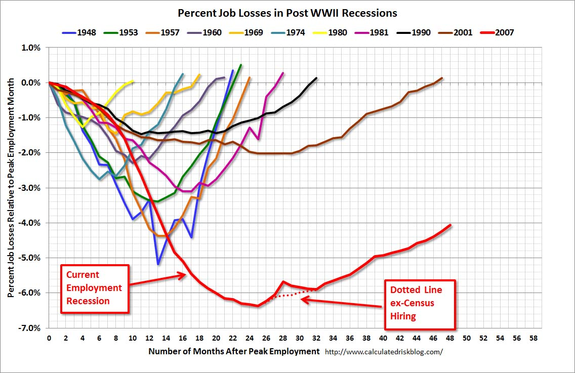
U.S. Percent Job Losses and Months for Recovery of Recessions

Slide 14
CHARACTERISTICS OF FINANCIAL CRISIS
(1) Asset Values Plunge = Equities 55% (3.5 yrs.), Home Values 35% (6 yrs.).
(2) Severe Recession = Profound declines in output and emp. Output down 9 percent (2 yrs), unemployment rises 7% (4 yrs.). US GDP in 2007 was $13.2b & 2012 $13.6b 4.6m less jobs.
(3) Explosion in Gov’t Debt = up 86%.
Source: This Time is Different: Eight Centuries of Financial Folly, Carmen M. Reinhart & Kenneth S. Rogoff, 2009.
Financial Crises and Economic Activity, Stephen G. Cecchetti, Marion Kohler and Christian Upper, 2009.

Slide 15
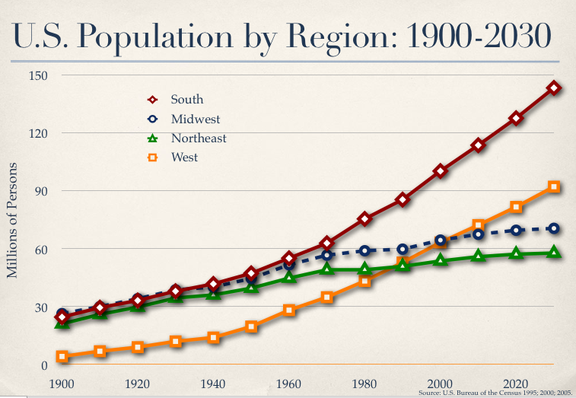
West: A High Growth Region

Slide 16
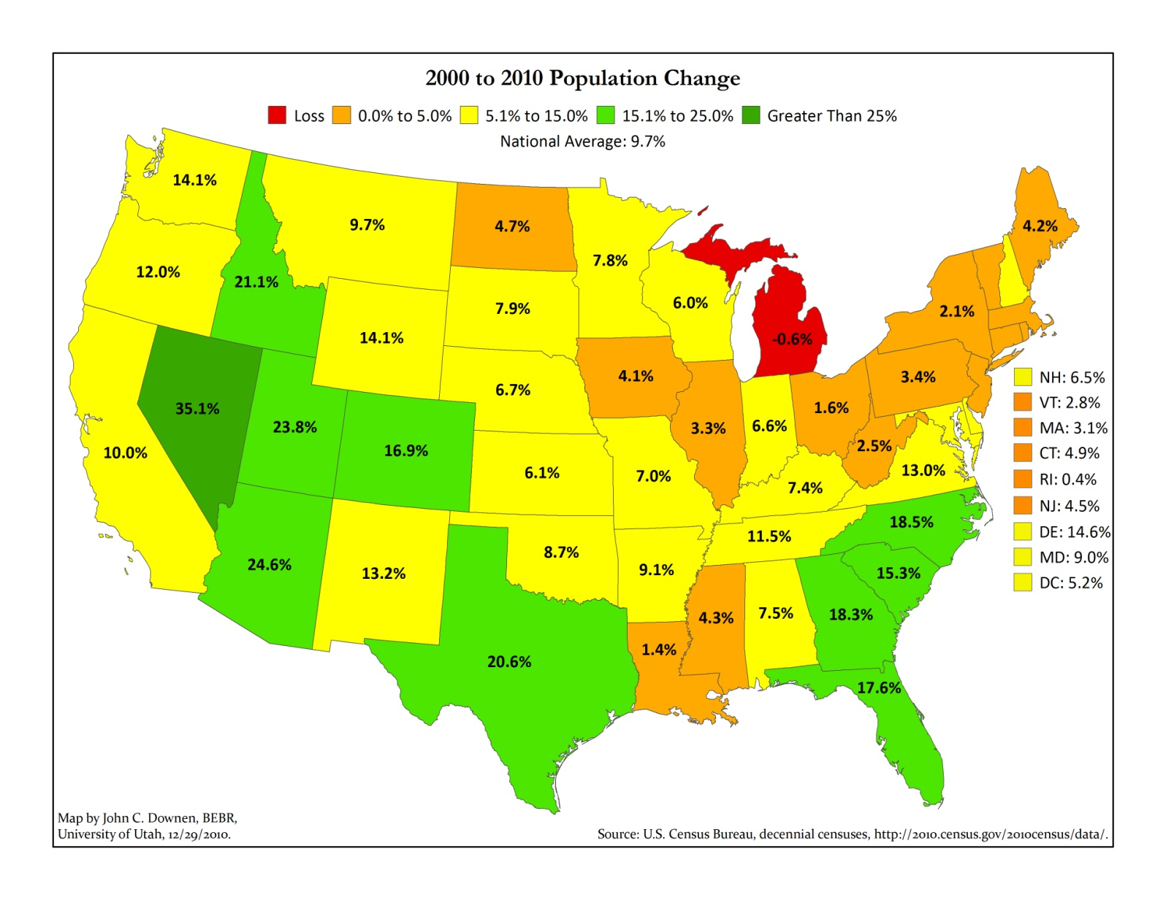
Percent Change in Population by State 2000-2010 Utah Ranks 3rd

Slide 17
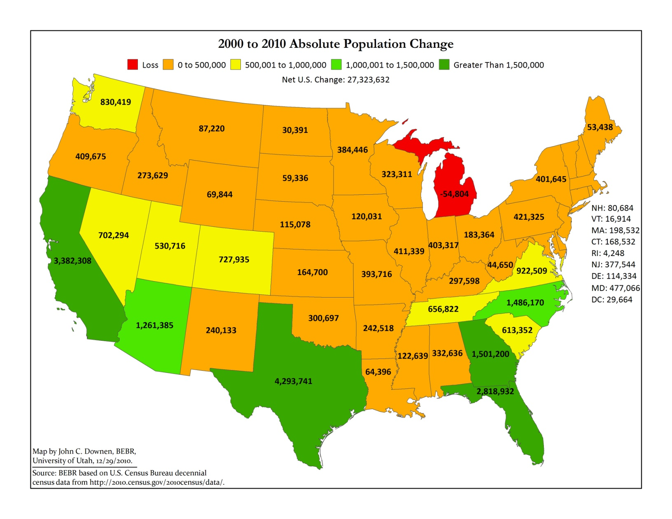
Absolute Change in Population by State 2000-2010 Utah Ranks 13th

Slide 18
CHANGE IN EMPLOYMENT IN UTAH
Source: Utah Department of Workforce Services.
9.6%
7.3%
6.2%
4.9%

Slide 19
Tuition Cost Academic Year
 | 2000-2001 | 2010-2011 | % Chg
U of U | $2,895 | $6,274 | 116.7%
Utah State | $2,401 | $5,150 | 114.5%
Weber State | $2,106 | $4,311 | 104.7%
SUU | $2,067 | $4,736 | 129.1%
UVU | $1,682 | $4,288 | 154.9%
SLCC | $1,636 | $2,932 | 79.2%
BYU (LDS) | $3,060 | $4,560 | 49.0%
BYU (Non-LDS) | $4,600 | $9,120 | 98.3%

Slide 20
Educational Attainment in Utah
(1) In 2000 Utah ranked 15th with 26.8% of workers with at least bachelor’s degree.
(2) In 2010 Utah ranked 20th with 28.5%.
(3) Decline due in part to lower educational attainment of women. In Utah only 26.4% of women have at least BS compared to 27.3% in US.
(4) Utah males 32.4% have at least BS compared to 28.5% nationally.

Slide 21
Value of Residential and NonRes. Construction in Utah (2011 Dollars – Mil $)

Slide 22
Pent-Up Housing Demand
Supply:
1. Builders Have No Unsold Inventory.
2. Real Estate Listings Are Down, Prices Increasing.
3. Market Bordering on Shortage.
Demand:
1. Household Formations of Average 14,500Annually 2011 - 2014
2. Plus Release of Doubled-Up Households.

Slide 23
Change in Median Sales Price of Existing Homes
 | Peak Value | Peak Qtr | 1st Qtr 2012 | % Chg. from Peak
FHFA State (Index) | 324.3 | Qtr 3rd 2007 | 242.6 | -25.2%
NAR Was.Front | $246,600 | 3rd Qtr 2007 | $182,600 | -26.0%
WFRMLS SL County | $256,000 | 3rd Qtr 2007 | $190,000 | -25.7%
Wash. Co. | $287,000 | 2006 | $175,000 | -39.0%

Slide 24
Short Sales and REO Sales in Salt Lake and Utah Counties Source: WFRMLS.
 | Short Sale | REO Sale | Total SS/REO | Total Home Sales | SS/REO % of Total Home Sales
Salt Lake
2009 | 1,117 | 436 | 1,553 | 8,904 | 17.4%
2010 | 1,210 | 1,276 | 2,486 | 8,567 | 29.0%
2011 | 1,376 | 1,719 | 3,095 | 9,414 | 32.8%
Utah Co.
2009 | 663 | 317 | 980 | 4,069 | 24.1%
2010 | 755 | 589 | 1,344 | 3,872 | 34.7%
2011 | 857 | 866 | 1,723 | 4,400 | 39.2%

Slide 25
Percent of Home Mortgages Filed for Foreclosure – Utah (Source: Mortgage Bankers Association.

Slide 26
All-Time High: Utah’s Government Funded Construction Projects
Project | Cost
Highway Cnst (2009-2012 Avg.) | $1.21 billion
NSA (2010-2013) | $1.5 billion
USTAR | $130 million
Natural History Museum | $97 million
Salt Lake City Public Safety Bldg | $120 million
Frank E. Moss Federal Court House | $100 million
Expansion Huntsman Cancer Center | $100 million
FBI Office Bldg | $75 million
Pharmacy (U of U) | $66 million
Honors Housing | $31 million
Eccles School of Business | $70 million
Neuropsychiatric | $47 million

Slide 27
Forecast for Utah’s Major Economic Indicators Source: Governor’s Office of Planning and Budget.
Category | 2010 | 2011 | 2012 | % Chg 2011-12
Nonfarm Emp. (000) | 1,181.5 | 1,209.1 | 1,238.8 | 2.5%
Unemp. Rate | 7.7% | 7.1% | 6.7% | ---
Total Wages (billion) | $45.7 | $48.1 | $51.0 | 6.0%
Average Pay | $38,665 | $39,811 | $41,070 | 3.2%
Net Migration (000) | 13.5 | 4.8 | 3.7 | ---
New Auto/Truck (000) | 69.1 | 81.6 | 92.5 | 13.2%
Residential Units | 9,300 | 8,800 | 11,000 | 25.0%
Residential Value (bil) | $1.7 | $1.8 | $2.15 | 19.4%
NonRes. Value (mil) Permit Authorized | $925 | $1,100 | $750 | -32%
Retail Sales (billion) | $25.1 | $26.4 | $28.1 | 6.6%
Exports (billion) | $13.6 | $19.0 | $18.5 | -2.8%
Housing Prices (FHFA) | -3.7% | -3.5% | -0.2% | ---

