Slide 1
Entrepreneurial Skills and Careers

Slide 2
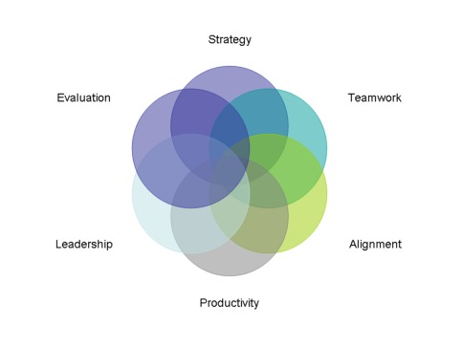
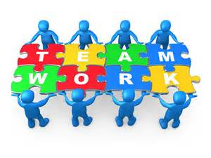
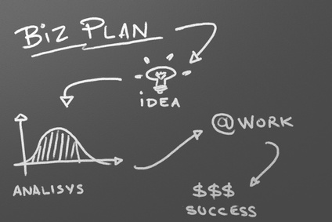
Need for Entrepreneurial Skills
“Since small businesses have created the majority of new jobs over the last few decades, in this period of major economic restructuring it is essential that education professionals focus on essential entrepreneurial skills to stimulate new business creation. the entrepreneurial competencies essential to the 21st Century Workplace are provided to the present and future worker force.
It is not enough to know how to fix a computer network or build a house, one must have the appropriate entrepreneurial skills to make it a successful business“
- Hank Kopcial, NFIB Young Entrepreneur Foundation

Slide 3
Entrepreneurship can be risky…
Sporadic Income
Business will fail and lose investment
Possibly liable for debts
Harder to find work or start again
Less Security (perhaps)

Slide 4
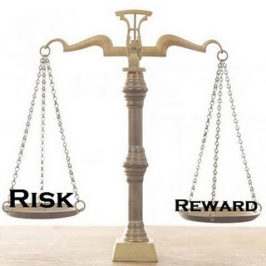
Taking a Calculated Risk
“A risk that has been given thoughtful consideration and for which the potential costs and potential benefits have been weighted and considered”
Owner-entrepreneurship education empowers young people to make well-informed decisions about their future, whether they choose to become entrepreneurs or not.

Slide 5
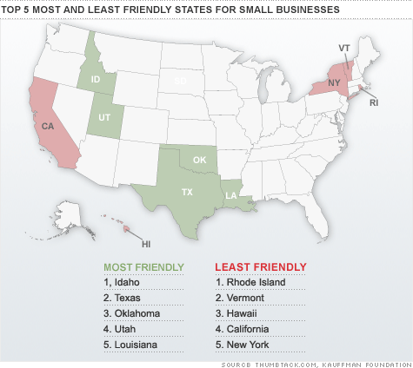
Financial Rewards
Profits
Capital Growth
Facebook - Mark Zuckerberg launched Facebook around age 20
The Body Shop – Dame Anita Roddick started at age 27 with 15 products
Spanx – Sara Blakely started at age 28
Wal-Mart – Sam Walton started at age 26

Slide 6
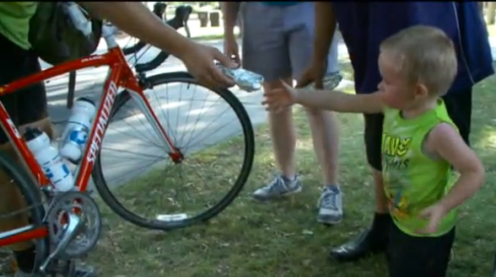
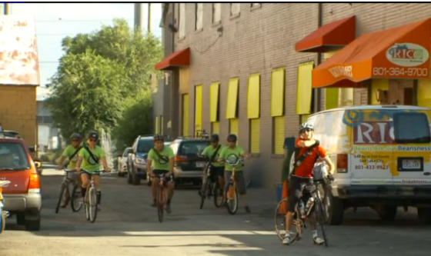
Non-financial Rewards
Independence
A sense of satisfaction
Building something
Being in control
Employing more people
Making a contribution to community
The Burrito Project – Salt Lake City

Slide 7
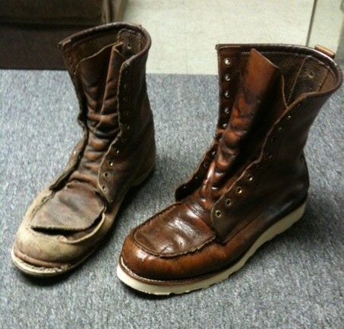
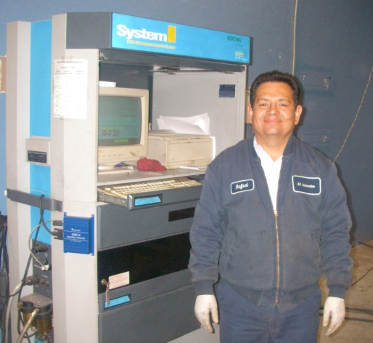
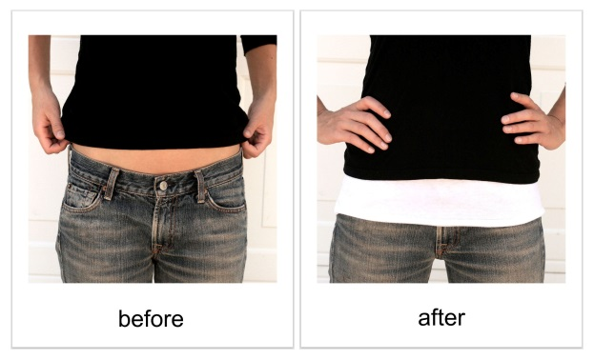
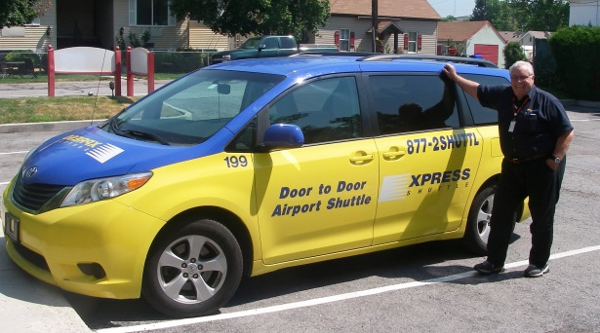
Find a “need” (opportunity) and figure out how to meet it
A “need” for a sober living environment
A “need” for shoe and leather repair
A “need” for car inspections
A “need” for airport transportation
A “need” for child care.
A “need” for a shirt extender

Slide 8
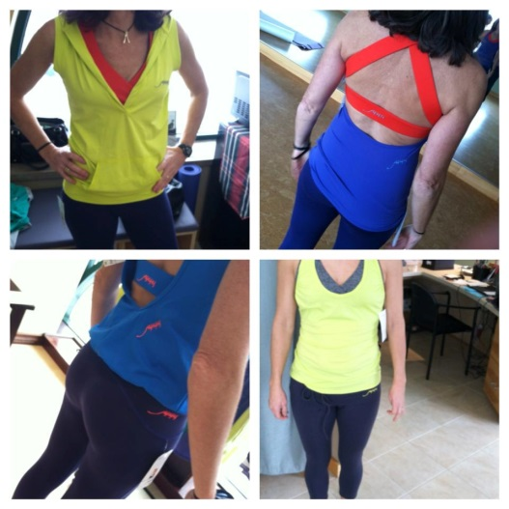
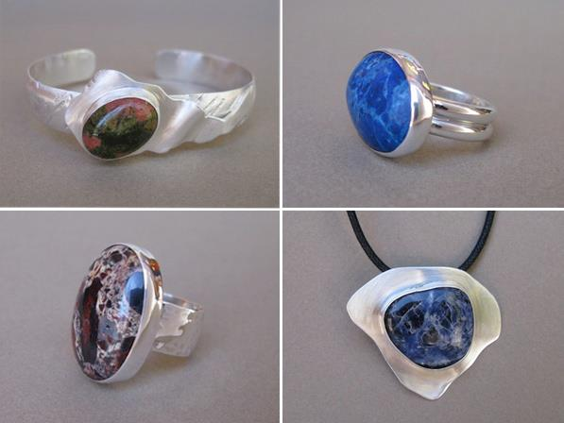
Find a “want” (opportunity) and figure out how to meet it
A “want” to snow-kite
A “want” for chic, fun fitness apparel.
A “want” to make own jewelry and wedding rings
A “need” for a hostess gift and a “want” for chocolate

Slide 9
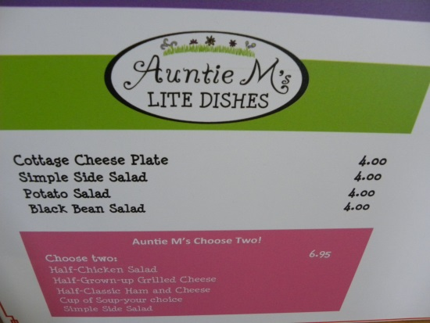
Most entrepreneurs are good at what they do, BUT they don’t know how to plan for and operate a small business
Attorneys
Doctors
Dentists
Architects
Accountants
Interpreters & Translators
Financial Analysts
Optometrists
Home Health Care Providers
Web Designers
Insurance Agents
Non-profit directors*
Funeral Directors
Tour Guides
Caterer
Restaurant Owner
Marriage, Child and Family Counselors
Travel and Transportation Agents
Veterinarians
Plumbers
Hair Stylist

Slide 10
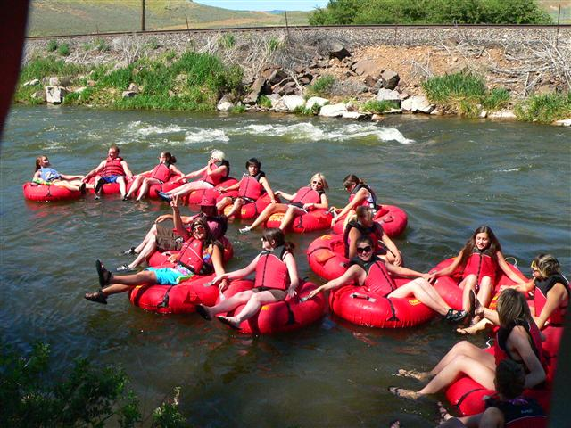
Why should students care about entrepreneur education?
Entrepreneurship allows you to dream your own destiny and craft a job that you can excel at.
If you're going to spend time doing something, why not spend time doing something you love? Pursue your passion.
Resume Builder. What looks better on a resume -- someone who started a lawn-mowing business and made sales as a teenage or someone who worked as a cashier in a local supermarket?
Students already own five powerful assets: time, talent, attitude, energy and unique knowledge of one’s local market.
Barefoot Tubing

Slide 11
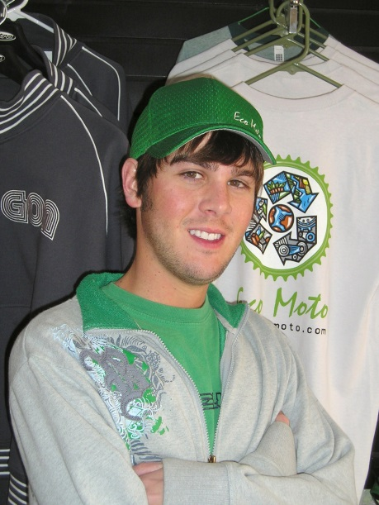
Why should parents care about entrepreneurship education?
“I’ve seen apathetic kids whose families have been on welfare for generations get excited about school and their futures. They discover that they can participate in our economy and earn money. They quickly realize that to do so, they must to learn to read, write and do math.”
“I’ve also seen how owning even the simplest small business fills a teen with pride.”
* Why Every School in America Should Teach Entrepreneurship, Steve Mariotti – Network for Teaching Entrepreneurship (NFTE)

Slide 12
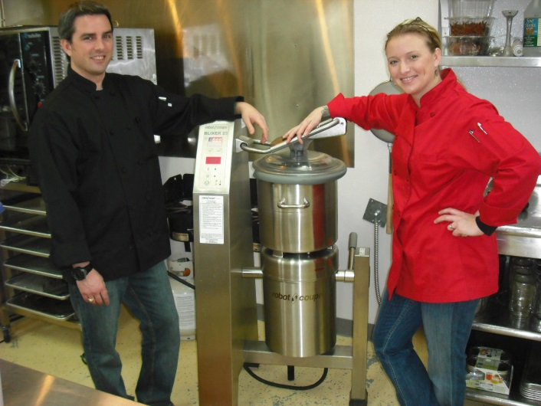
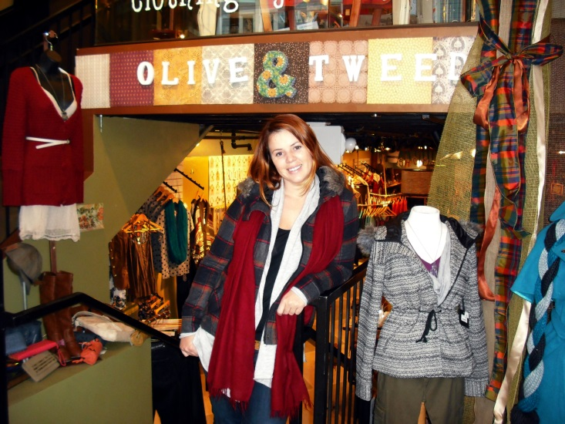
Skills for a lifetime…
Remember - entrepreneurs who have built and sold one business for a substantial amount go on to build other successful businesses. They never lose the entrepreneurial buzz.
Happy Monkey Hummus

Slide 13
